Slide 1
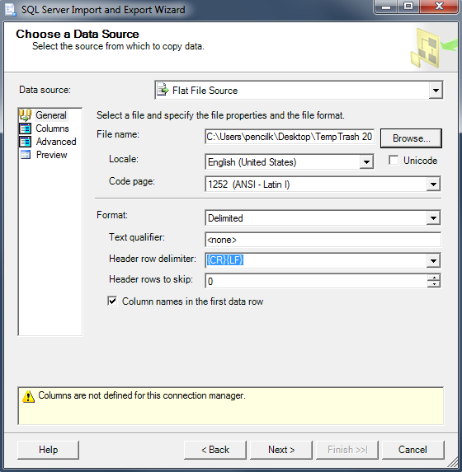
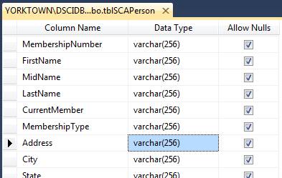
The Sister Cities Database
Development Project
The step described in this set of slides are marked here in red.
Prepare data for importing
Import data; simultaneously … creating the new table (STRINGS THAT LOOK LIKE NUMBERS)
Modify the table design
Original Data →
Prepped Data →
Import Wizard →
“Design” Window →
This presentation was prepared by Professor Steve Ross and modified by Kraig, with the advice of other MIS Faculty, for use in MIS Classes at Western Washington University. Please contact Dr. Ross for permission to use in other settings..

Slide 2
Wizards are Wonderful, but …
Complications are not uncommon with import Wizards. The Wizard interprets the data according to the rules it has been programmed with. Sometimes that interpretation incorrect.
One such problem can occur when the Excel data contains strings that look like numbers, but are not actually numbers. For example, telephone numbers or ZIP codes. The Wizard will define the phone number in the import table as a numeric field in the database table it creates. The phone numbers and the ZIP codes get corrupted in the process.

Slide 3
Solutions to the Wizard Problem
Solutions to this particular problem may include…
Exporting the data from the Excel spreadsheet to a text file (e.g. NotePad) first, then importing the data from the NotePad document, rather than directly from the spreadsheet.
Modifying the data in the Excel spreadsheet so it is clearly a string. For example, you could add “x” to the beginning of every phone number or ZIP code: X555-1234. If you modify the data, of course you must undo the alteration after the data has been imported. You need to be careful to use this method because alternating the imported data may be not easy.
The following slides show how Method 1 might be implemented. For extra practice, you can try Method 2 on your own.

Slide 4
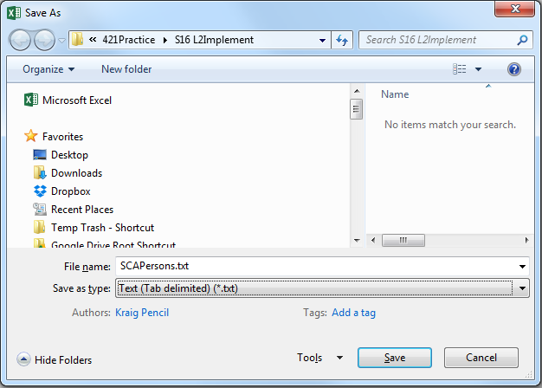
Export the Spreadsheet
File tab – Save As command
Give the file a recognizable name, e.g., WorkersTab
Save as type: Text (Tab delimited)
If there are multiple sheets, a dialog box will ask if it is OK to save only active sheet – click OK
Close Excel after the Save

Slide 5
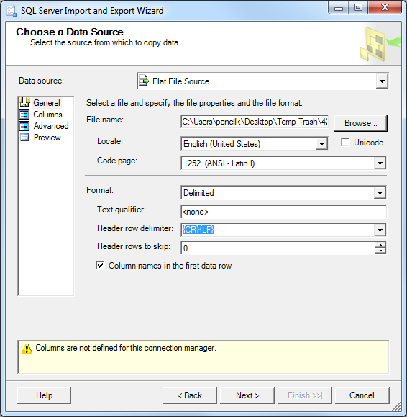
Import the Data
Import the data
Right-click Database name; choose Tasks; choose Import Data…; click Next > on the splash screen
Choose the Data Source (Flat File Source) and browse to locate the file →
Note these settings
click Next > twice

Slide 6
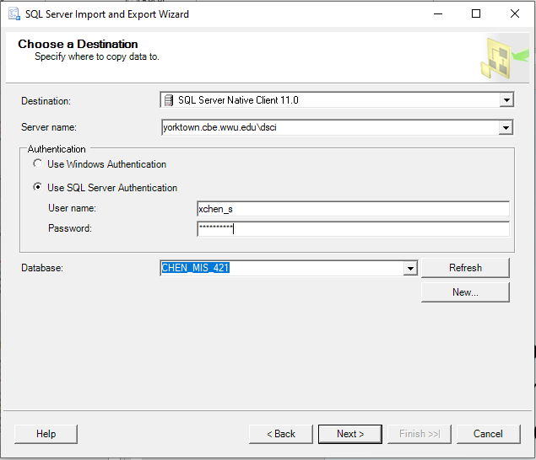
Import the Data
Import the data
Choose the destination as shown
Enter the server name: yorktown.cbe.wwu.edu\dsci
Use SQL Server Authentication
Make sure your database is shown in the dropdown menu for Database:
then click Next

Slide 7
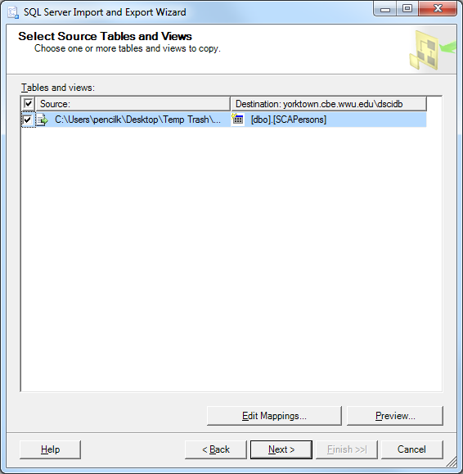
Import the Data
Import the data
Select Source Table →
Click Edit Mappings… (see next slide)

Slide 8
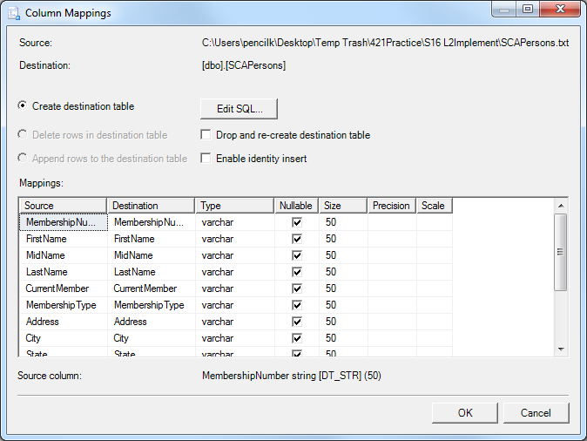
Import the Data
Import the data
Click Edit Mappings… → change as req., click OK, then Next >
{on the next screen} Choose Run Package immediately; click Next >
{on the next screen} Click Finish

Slide 9
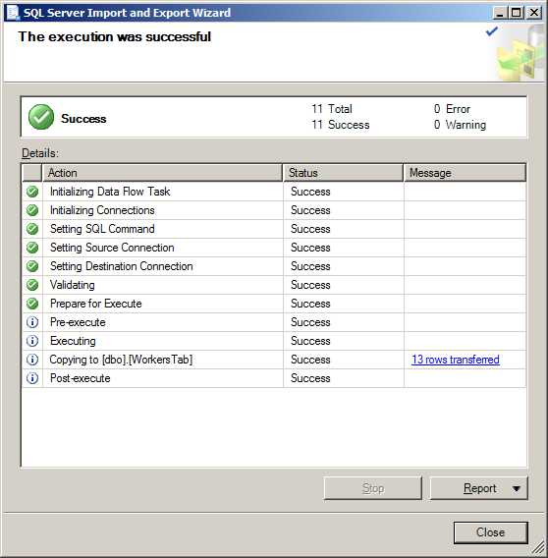
Import the Data
Import the data
Read the report, then Close.

Slide 10
Verify the Results
Inspect the table (right-click table name, choose Select Top 1000 Rows)
Data in expected columns
Numeric data format, ensure no loss
Character data, check for truncation

